Slide 1
Validating R for Pharma
Streamlining the Validation of Open-Source R Packages within Highly Regulated Pharmaceutical Work
Presented by Anuja Das on behalf of the R Validation Hub

Slide 2
Agenda
The R Validation Hub
Our White Paper
{riskmetric}
{riskassessment}
Regulatory R Package Repository
Communications
1
2
3
4
5
6

Slide 3

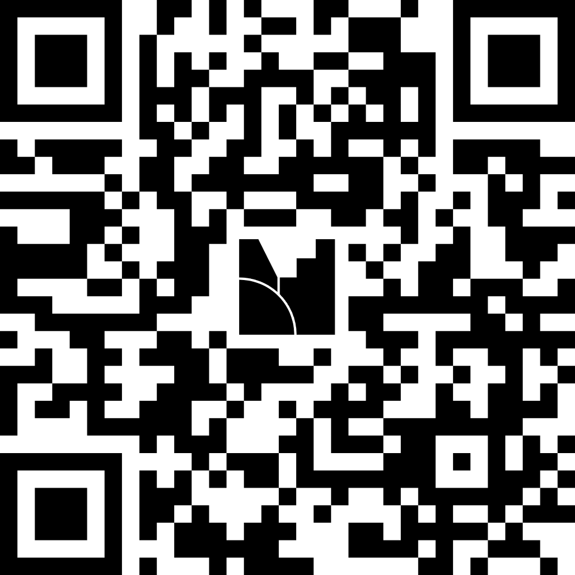
BUT FIRST

Slide 4

Some companies are:
Abbvie
Biogen
Lilly
Merck
Parexel
Posit
Roche
Sanofi
And many more…
What is the R Validation Hub?
Nested under the R Consortium
Cross industry collaboration of over fifty biotech and pharmaceutical companies
Initial aim: Consolidate definitions, regulations, and best practices for qualification and validation of the open-source language
Current State: Grown to include a variety of workstreams that produce resources and tools for open-source use aligning with the expectations of regulatory agencies

Slide 5
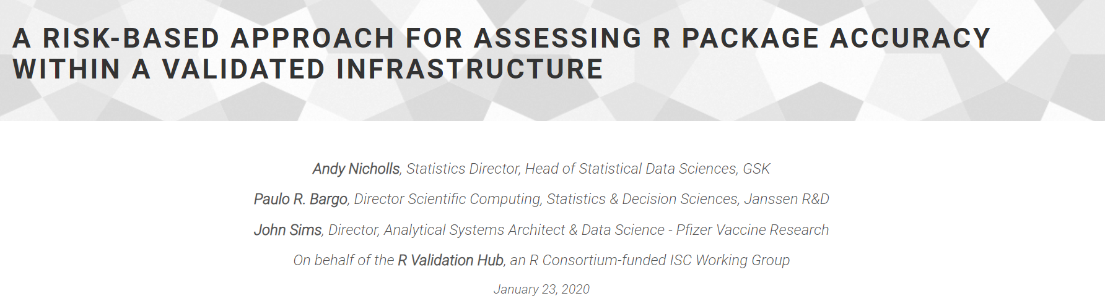
The White Paper

Slide 6



The White Paper
A Risk-Based Approach for Assessing R Package Accuracy within a Validated Infrastructure
Focuses on systems validation and adequate testing and documentation in keeping with the FDA’s “Statistical Software Clarifying Statement”
Accuracy
Reproducibility
Traceability
“For Intended Use”

Slide 7
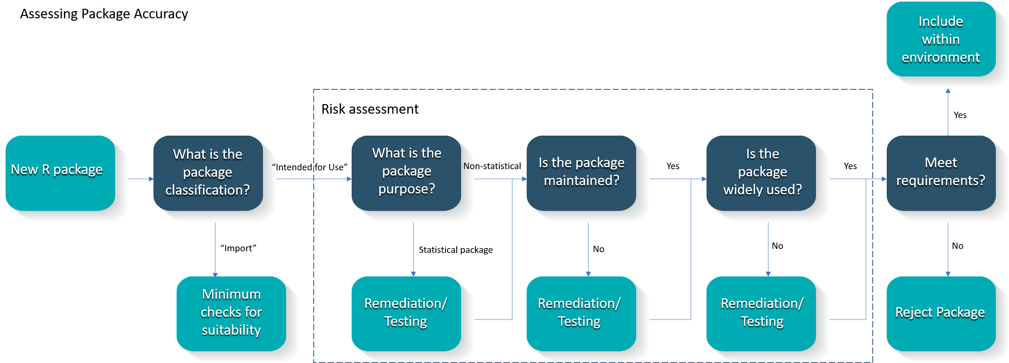
The White Paper
Proposed Risk-Based Approach to Assess Accuracy

Slide 8
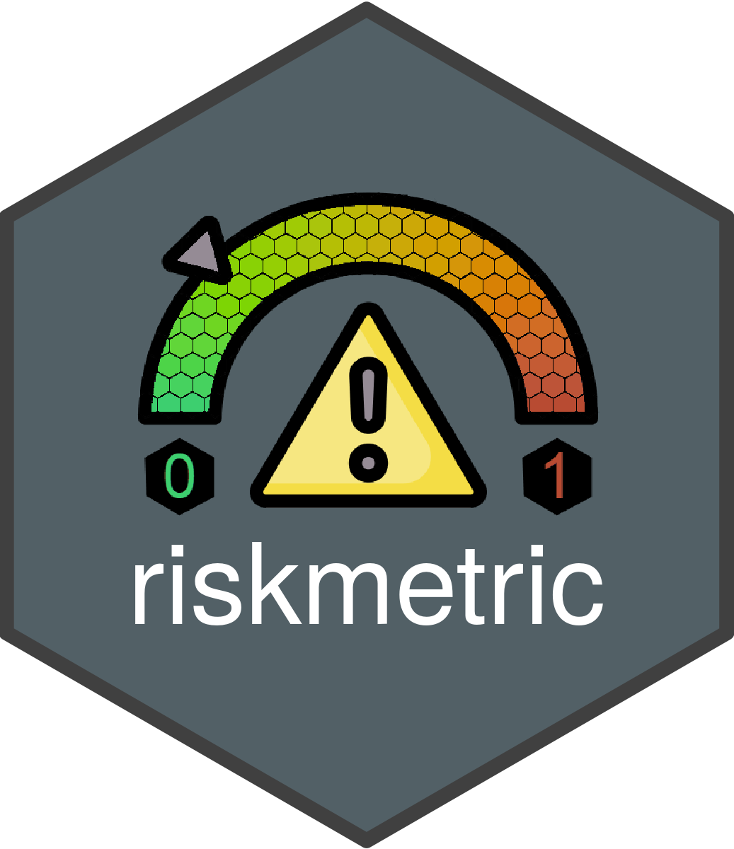
Tool 1: Quantify Risk Programmatically

Slide 9
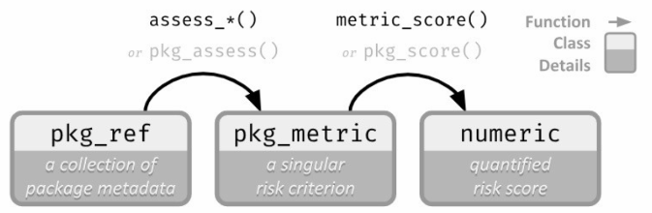
{riskmetric}
How it Works
Perceived Risk
Quantified Risk

Slide 10
{riskmetric}
How Quality can be Quantified
A license
Source code available for browsing
An easy to contact maintainer
Up-to-date news regarding new features and bugs
A place to report bugs
Evidence that new bugs are being addressed
Package documentation & user guides/ perhaps a website
Complete Function documentation
Adequate test coverage
Community usage
Many more!
Unit Testing Metrics
Documentation Metrics
Community Engagement
Maintenance & Reusability

Slide 11
{riskmetric}
Who can use this?
Users | Usage
Package Developers
System Administrators
Programmers

Slide 12
{riskmetric}
Who can use this?
Package Developers
Initial testing and subsequent assessment of package complexity and use
Programmers
Determining packages to use in day-to-day work
System Administrator
Understanding additional validation needed

Slide 13
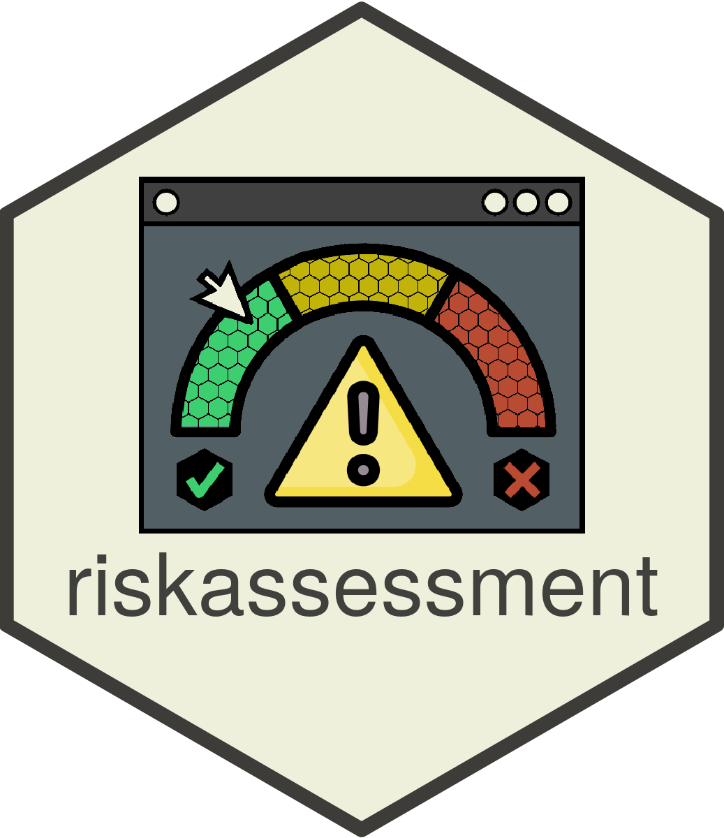

Tool 2: Interactive App using {riskmetric}
Voted ‘Best App’ at Shiny Conference 2023

Slide 14
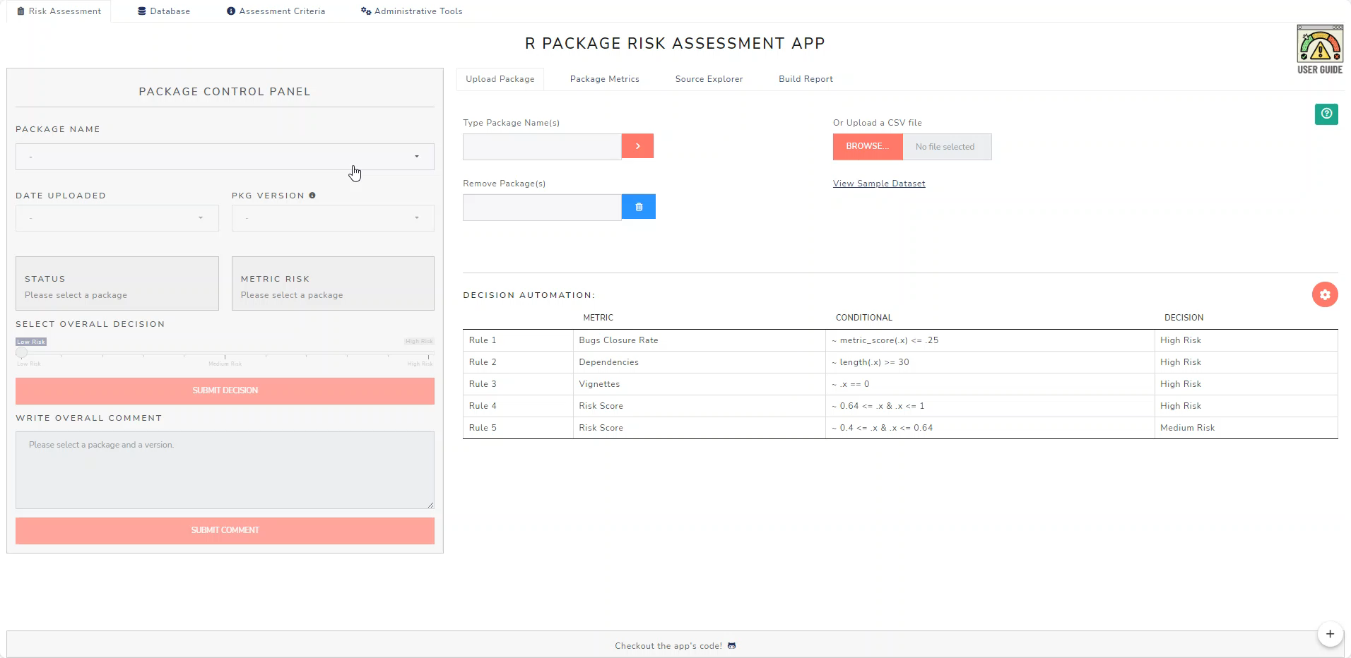
{riskassessment}
How it Works

Slide 15
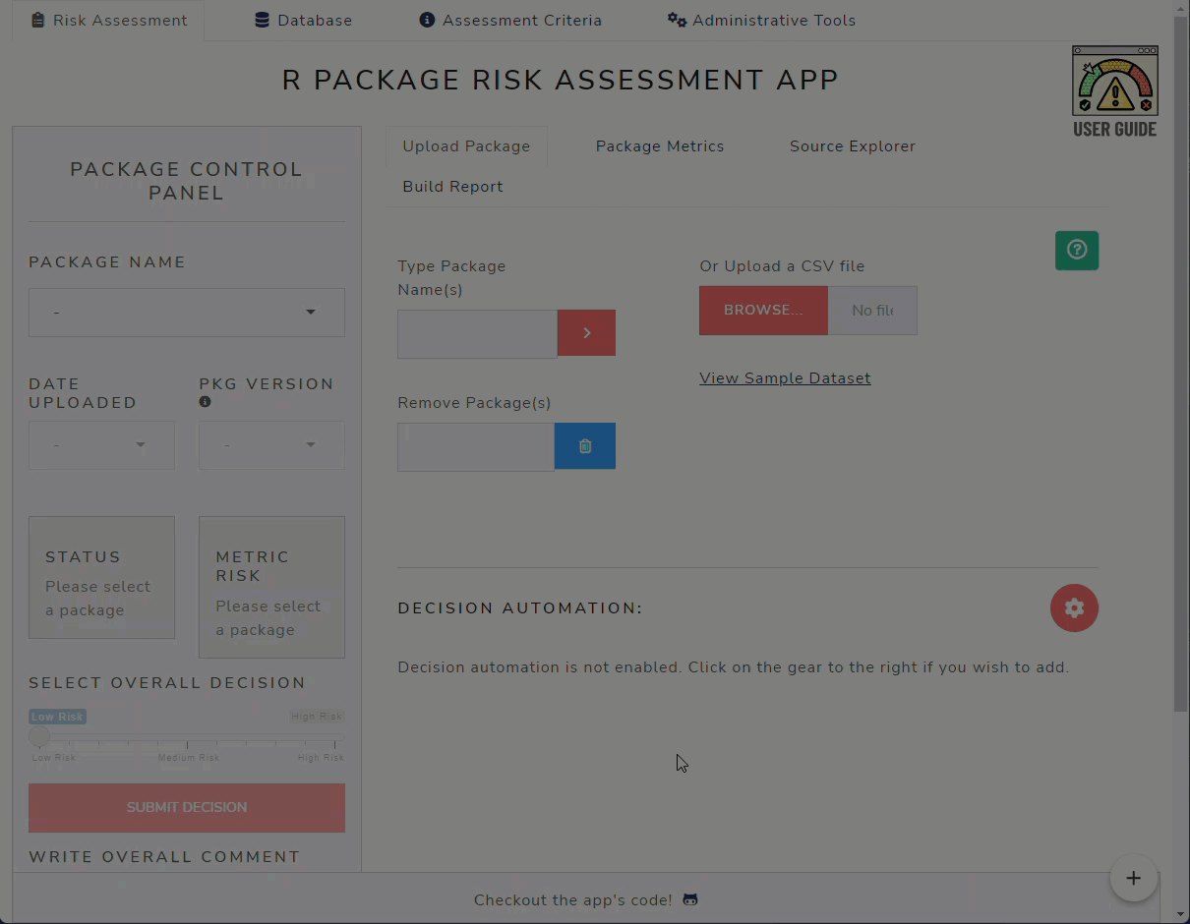
{riskassessment}
Decision Automation – Integration with {riskassessment}

Slide 16
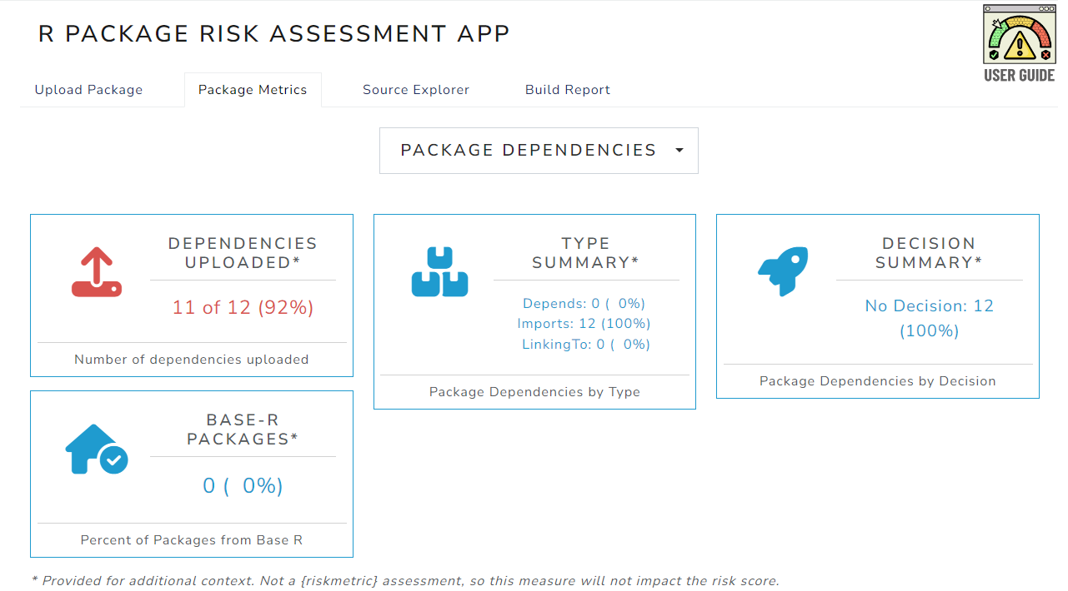
{riskassessment}
Exploring Dependencies

Slide 17

Repositories Workstream

Slide 18
Regulatory Repositories
Business Driver and Scope
Why?
Scope for the Pilot
Simplify the burden of assembling and storing documentation and evidence of R Package testing and validation assessments
Cross-industry repository would reflect the true essence of open-source collaboration
Ultimate risk reduction of using R packages for regulatory submissions
Base Reference Image
Basic Automated Validated Pipeline
Basic Repository to store and manage validated R packages
Slated for Q3 2024

Slide 19

Communications

Slide 20
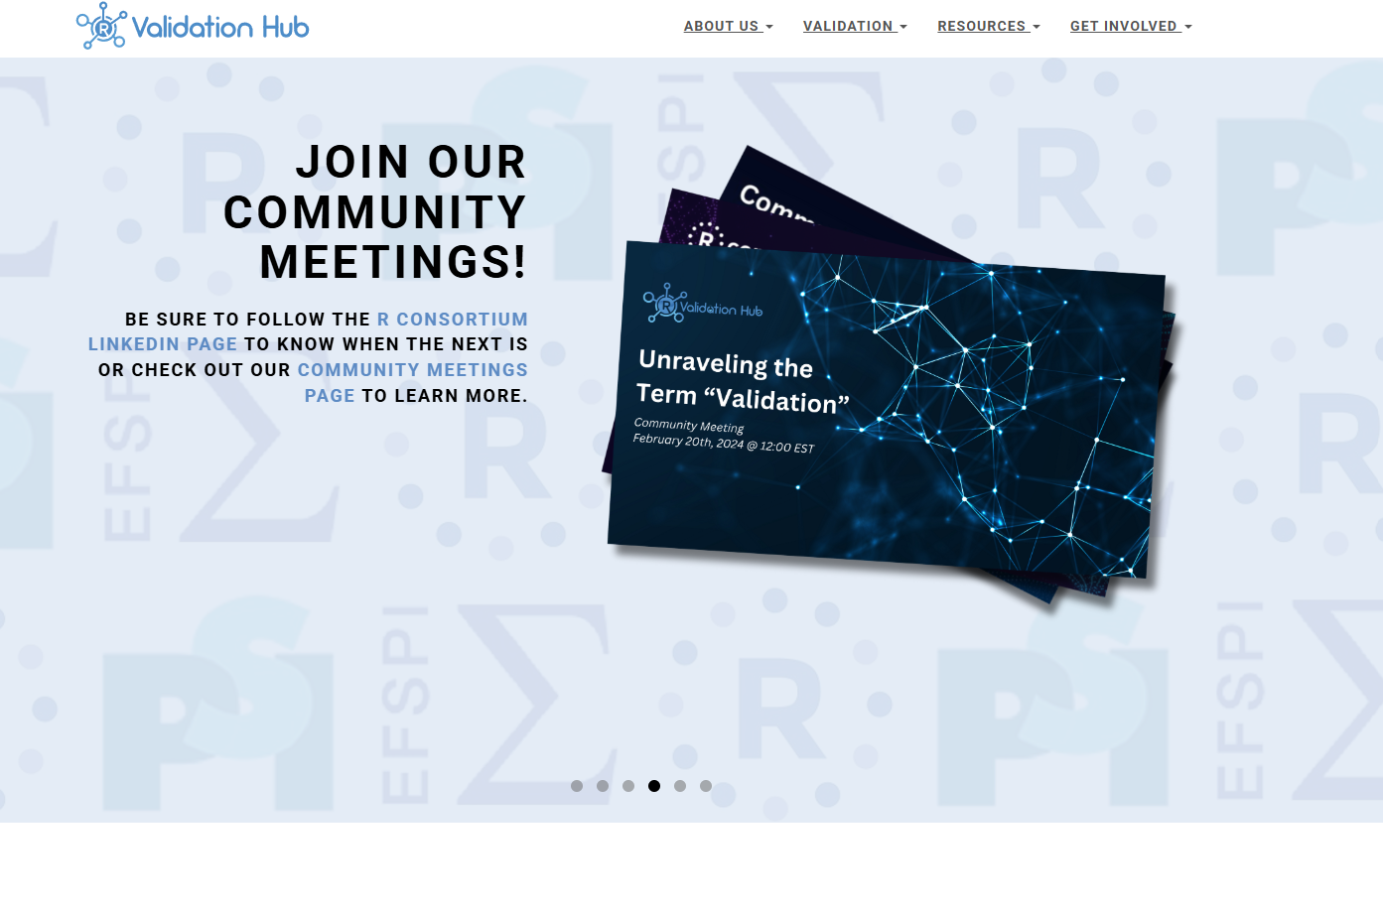
Communications
Our Platforms
Website
Community Meetings
Past topics have included:
Unraveling the term ‘Validation’
A Deep Dive into our tools and resources
Reflecting on industry case studies
pharmar.org

Slide 21




Communications
Get Involved!!!
The R Validation Hub is always looking to expand their network. These are a few ways to join in.
Be a part of our Working Groups
Join our mailing list and attend Community Meetings
Tell us your ideas
Submit a Case Study

Slide 22
Questions
Key Contacts:
Presentation and Communication: Anuja Das Anuja.das@biogen.com
{riskmetric}: Eric Milliman eric.milliman@biogen.com
{riskassessment} Aaron Clark aclark02@arcusbio.com
R Regulatory Repositories Coline Zeballos coline.zeballos@roche.com

